Slide 1
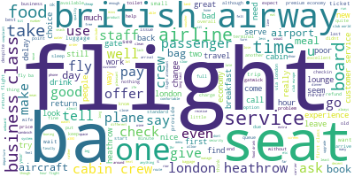
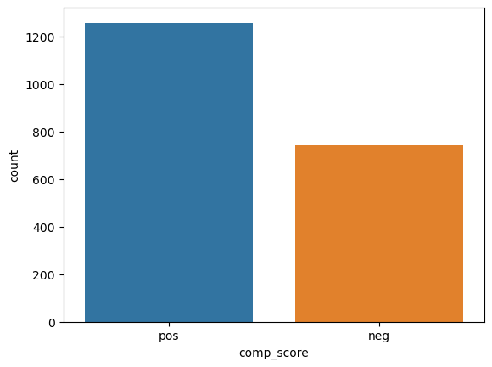
British airways reviews sentiment analysis
Topics gleaned from the extracted reviews cover fliers’ view of the following areas:
Book Airline
Business Class
Business and Economy Class Customer Experience
British Airways’ Heathrow Airport Operations
Meal Service
Most reviews are positive. Over 1200 out of 2000 reviews are positive. Nearly 700 reviews are negative. The mean score is 0.233 and median is 0.545.

